Slide 1


Predictive Maintenance in Solar Power Systems
AI-Driven Solutions for Enhanced Efficiency and Sustainability

Slide 2
VENKATESH.P (Team Leader-S4F_CP_Team_12209)
SHACHIN.S (Team Member-S4F_CP_Team_12209)
SEDHURAMAN.P (Team Member-S4F_CP_Team_12209)
PRADEEP.R(Team Member-S4F_CP_Team_12209)
VENKATESH.S(Team Member-S4F_CP_Team_12209)

Slide 3
Content
Abstract
Problem Statement
Objective
Data Collection and Preparation
Proposed Solution (Methodology)
Model Performance Evaluation
Screenshots / Demonstration (video)
Future Scope
Conclusion
Notes:
Abstract
Problem Statement (Clearly define the challenge)
Objective (State your project's goal)
Background and Research (Discuss existing solutions, trends, and gaps)
Data Collection and Preparation (Focus on data sources, cleaning, and augmentation)
Proposed Solution (Methodology)
Model Architecture (e.g., CNN, U-Net, YOLOv5)
Key Techniques (e.g., Transfer Learning, Image Augmentation)
Model Performance Evaluation
Metrics (Accuracy, Precision, Recall, IoU, etc.)
Graphs (Confusion Matrix, ROC Curve, etc.)
Screenshots / Demonstration (Visual proof of system functionality)
Future Scope (Improvements, scalability, and integration ideas)
Conclusion (Summarize results and impact)
Q&A Session

Slide 4
Abstract
Solar power plants are essential for clean energy. However, maintenance is challenging.
Breakdowns reduce power output and cause financial losses. Traditional time-based maintenance can lead to over- or under-maintenance.
Predictive maintenance using AI identifies issues before failures occur, improving reliability and efficiency.

Slide 5
Problem Statement
A solar farm in California had frequent inverter failures, reducing power output by 15% during peak hours.
By implementing machine learning, they analyzed sensor data, weather, and energy output to predict failures.
Results: 30% reduced downtime, increased energy production, and lower maintenance costs.

Slide 6
Objective
- Sensor Data: Temperature, voltage, current, power output
- Environmental: Ambient temperature, solar irradiance, weather
- Historical: Maintenance logs, past failures
- Engineered: Rolling averages, sudden changes, temperature differential

Slide 7
Data Collection and Preparation
- Preprocessing: Scaling, handling missing data
- Model: Random Forest (or XGBoost for higher accuracy)
- Output: Predicts potential inverter failure
- Evaluation: Classification report, feature importance

Slide 8
Proposed Solution (Methodology)
- Hyperparameter tuning (GridSearchCV)
- Use time-series models (LSTM)
- Data augmentation for imbalance
- Ensemble models for better performance

Slide 9
Model Performance Evaluation
- Send alerts to maintenance teams
- Schedule preemptive maintenance
- Reroute power through working inverters
- Log data for continuous learning

Slide 10
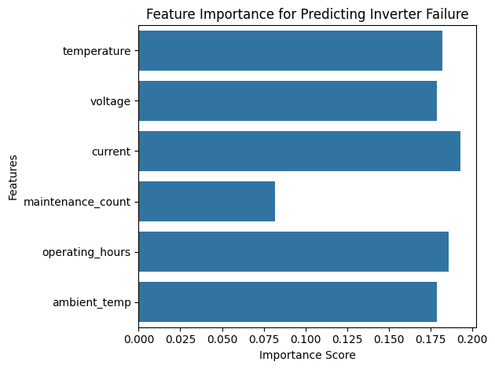
Screenshots / Demonstration (video)
Github Link : https://github.com/Venky512c/-Predictive-Maintenance-in-Solar-Power-Systems

Slide 11
Future Scope
- Reduce equipment waste and downtime
- Increase renewable energy production
- Extend lifespan of components
- Lower emissions from maintenance logistics

Slide 12
1. What features in the dataset are most important for predicting equipment failures?
Feature | Reason for Importance
Temperature | High or fluctuating temps can degrade performance and cause failure.
Voltage | Unstable voltage may indicate inverter or panel issues.
Current | Drop or spike may reflect hardware faults or shading issues.
Maintenance Count | High frequency may suggest recurring issues.
Operating Hours | Helps model wear-and-tear over time.
Ambient Temp | Affects panel efficiency and can indirectly cause overheating.
Failure History | Prior failures may indicate components more likely to fail again.

Slide 13
2. Develop a machine learning model to predict inverter failure.
To develop a machine learning model for predicting inverter failure in solar power systems, the process begins with collecting and preparing historical sensor data. This data typically includes variables such as temperature, voltage, current, ambient temperature, maintenance count, and operating hours. The data is first cleaned, normalized, and split into training and testing sets. A supervised learning algorithm, such as a Random Forest Classifier, is then trained on the labeled dataset where the target variable indicates whether an inverter failure occurred. The model learns patterns and correlations between sensor readings and past failures. After training, the model's performance is evaluated using metrics like accuracy, precision, recall, and F1-score. A well-performing model can then be used to predict potential inverter failures in real-time, allowing for timely maintenance and minimizing downtime in solar energy production.

Slide 14
3. How Would You Improve the Model's Accuracy?
To boost performance:
✅ Feature engineering: Add derived features like temperature-voltage ratio, rate of change.
✅ Hyperparameter tuning: Use GridSearchCV or RandomizedSearchCV.
✅ Balance the dataset: Use SMOTE or class weights to handle class imbalance.
✅ Use time-series models: LSTM or other sequence-based models if data is temporal.
✅ Ensemble methods: Try Gradient Boosting, XGBoost, or a voting classifier.

Slide 15
4. What actions should be taken if a failure is predicted?
Action Plan:
🛠 Trigger an alert: Notify technicians via app/email/SMS.
📅 Schedule preventive maintenance: Before full failure occurs.
🔁 Reroute power: Switch loads to functional inverters.
🧾 Log prediction: For audit trail and model learning.
📊 Update dashboard: Show at-risk equipment and urgency level.

Slide 16
5. How can predictive maintenance contribute to sustainability and reduce waste?
Sustainability Benefits:
♻️ Reduces waste: Fewer component replacements due to proactive care.
🔋 Improves energy efficiency: Minimizes downtime and energy loss.
🚛 Lowers emissions: Less emergency transport for last-minute repairs.
📉 Extends equipment lifespan: Early intervention prevents major damage.
💸 Cuts costs: Less reactive maintenance, more planned, cost-efficient servicing.

Slide 17
Conclusion
Predictive maintenance powered by AI enables smarter, greener, and more efficient solar power systems.
With real-time monitoring and prediction, solar farms can reduce waste, improve energy output, and enhance reliability.

